Slide 1
Harmony in Family
Understanding Relationship
– Respect

Slide 2
Harmony in the Family
Relationship is – between one self (I₁) and other self (I₂)
There are feelings in relationship – in one self (I₁) for other self (I₂)
These feelings can be recognized – they are definite (9 Feelings)
Their fulfilment, evaluation leads to mutual happiness
Feelings in relationship:
1- Trust fo”okl FOUNDATION VALUE
2- Respect lEeku
3- Affection Lusg
4- Care eerk
5- Guidance okRlY;
6- Reverence J)k
7- Glory xkSjo
8- Gratitude —rKrk
9- Love izse COMPLETE VALUE

Slide 3
Respect (lEeku)
Respect = Right Evaluation
lEeku ¾ le~ $ eku
lE;d~ ekiuk
Bhd Bhd vkWadyu djuk

Slide 4
Over evaluation – to evaluate for more than what it is
vf/kewY;u vf/kd vkaadyu djuk
Under evaluation – to evaluate for less than what it is
voewY;u de vkaadyu djuk
Otherwise evaluation – to evaluate for other than what it is
vewY;u vU;Fkk vkaadyu djuk
Whenever the evaluation is not right, it is disrespect
Check for yourself in every interaction with others whether it is respect or disrespect
If we observe, we find in our day to day relationship, we tend to do one of the above three, which is disrespect
Disrespect
vieku

Slide 5
Respect: Right Evaluation – on the basis of the Self (I)
Purpose y{;
    I want to live with continuous happiness & prosperity
    The other also wants to live with continuous happiness & prosperity
    Our purpose is similar (on the basis of Natural Acceptance)
Program dk;ZØe
    My program is to understand and to live in harmony at all 4 levels
    The program of the other is also to understand and to live in harmony at all 4 levels
    Our program is similar
Potential {kerk
    Desire, Thought & Expectation ¼bPNk] fopkj] vk”kk½ is continuous in me. I am endowed with Natural Acceptance
    Desire, Thought & Expectation ¼bPNk] fopkj] vk”kk½ is continuous in the other. The other is also endowed with Natural Acceptance
    Our potential is similar
The Other is Similar to Me nwljk esjs tSlk gS

Slide 6
Differentiation Hksn
Differentiation
Hksn
Differentiation = Disrespect
Not Naturally Acceptable… Opposition… Movement…
Hksn ¾ vieku
lgt Lohdk;Z ugha gksrk--- fojks/k--- vkUnksyu---
Body
“kjhj
Physical Facility
lqfo/kk
Beliefs
ekU;rk
Age
vk;q
Gender
fyax
Race
oa”k
Physical
Strength
cy
Wealth
/ku
Post
in
Isms okn
Sects
laiznk;
Info
lwpuk

Slide 7
Differentiation Hksn
Differentiation
Hksn
Evaluation on the basis of Body, Physical Facility or Beliefs (preconditioning) turns out to be differentiation and therefore disrespect
Differentiation like this has led to resentments and protests. Eg Women's Lib, Generation Gap, Black vs White, Powerful vs Opressed, Rich-Poor, Communism-Capatalism, Hindu-Muslim and so on
Body
“kjhj
Physical Facility
lqfo/kk
Beliefs
ekU;rk
Age
vk;q
Gender
fyax
Race
oa”k
Physical
Strength
cy
Wealth
/ku
Post
in
Isms okn
Sects
laiznk;
Info
lwpuk

Slide 8
Respect: Right Evaluation – on the basis of the Self (I)
1. Purpose – Our purpose (Natural Acceptance) is similar
2. Program – Our program is similar
3. Potential – Our potential is similar
The Other is Similar to Me
4. Competence – On the basis of right evaluation of our mutual competence, I recognise our complementarity:
  If the other has more understanding, is more responsible than me
      I am committed to understand from the other
  If I have more understanding, I am more responsible than the other
      I live with responsibility with the other, unconditionally, unpeturbed by the behaviour of the other
      I am committed to facilitate understanding in the other (once the other is assured in relationship, and not before that)
The Other is Similar to Me. We are complementary to each other

Slide 9
Competence
Competence (Understanding) = Realisation, Understanding & Contemplation
Competence (Feeling) = How much of our desire, thought & expectation is on the basis of our Natural Acceptance
Competence (Skill) = Skills to do something specific
Feeling – Definite, Universal
Expression of Feeling – Creativity, Variety, Local

Slide 10
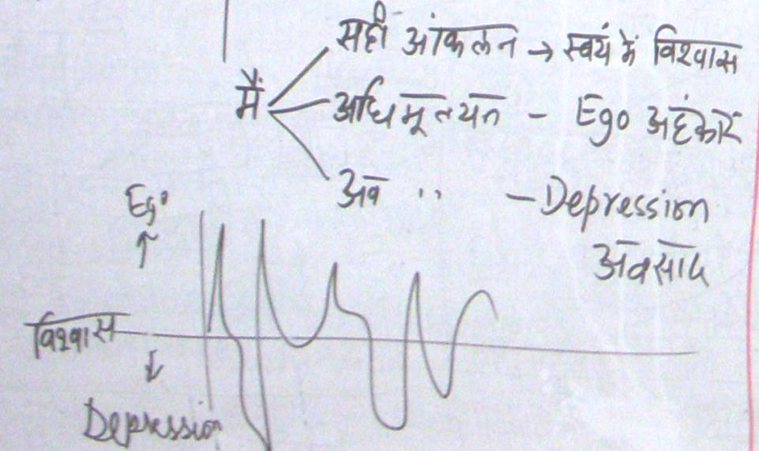
Self Confidence, Ego & Depression
Right Evaluation | Over Evaluation | Under / Otherwise Evaluation
Self Confidence | Ego | Depression
I am self referential (swatantrata) | The other is my reference (partantrata) | The other is my reference (partantrata)
Definite Conduct | Indefinite Conduct | Indefinite Conduct

Slide 11
What would be the basis for respect – Body or Self?
What effort are you making
– the other is similar to me – my effort is to be in accordance with my natural acceptance
– the other is not like me – my effort is to be special, to be different from the other
Current basis of respect is differentiation
If we understand this, we can live with a feeling of respect toward one, toward all
What is natural
– the other is similar to me, to live with a feeling of respect?
– differentiation, to live with a feeling of dis-respect?
So these feelings need to be ensured in me or
These feelings are to be expected from the other?

Slide 12
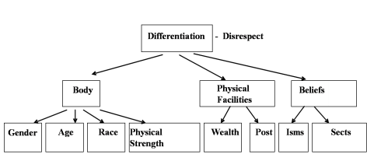
Differentiation Respect – on the basis of Self (I)
I evaluate on the basis of body, physical facilities or belief (pre conditioning). I compare with others
I am different from the other
We are competitors:
I make effort to accentuate the difference, to manipulate, exploit the other
1. Our purpose (Natural Acceptance) is similar
2. Our program is similar
3. Our potential is similar
The other is similar to me
We are complementary to each other:
If the other has more understanding
- I am committed to understand from the other
If I have more understanding
1. I live with responsibility with the other
2. I am committed to facilitate understanding in the other (once the other is assured in relationship, and not before that)

Slide 13
Trust & Respect – on the basis of Self(I)
Right Evaluation (with Trust on intention, the acceptance that the other is like me & the understanding that we are complementary to each other)
If I have more understanding than the other:
  I interact with perseverence and responsibly with the other, knowing that he/she may live with reaction, uncertain conduct
  facilitate understanding in the other once the other is assured in relationship (and not before that)
If the other has more understanding than me:
  I become ready to understand from the other
From what has been covered so far, right evaluation can include:
  Priority (Right Understanding, Relationship, Physical Facility)
  % desires motivated by Preconditioning, Sensation, Natural Acceptance
  Clarity, harmony in the Self (vs confusion…)
  Trust on Intention (vs doubt, irritation…)
  % response (vs reaction…)
Beginning of Development

Slide 14
Sum Up
Respect is Right Evaluation
Under evaluation, over evaluation or otherwise evaluation is disrespect
Differentiation is disrespect
Respect on the basis of Self(I) – The other is like me. We are complementary to each other. The only difference is in our level of understanding (how much of our desire, thought & expectation is on the basis of our Natural Acceptance)
If the other has more understanding & is more responsible than me
    I am committed to understand from the other
If I have more understanding & I am more responsible than the other
    I live with responsibility with the other, unconditionally, unpeturbed by the behaviour of the other
    I am committed to facilitate understanding in the other (once the other is assured in relationship, and not before that)

